Slide 1
Chapter 10
System Architecture

Slide 2
Learning Objectives (1 of 2)
After this chapter, you will be able to:
Provide a checklist of issues to consider when selecting a system architecture
Trace the evolution of system architecture from mainframes to current designs
Explain client/server architecture
Describe the impact of the Internet on system architecture
Compare in-house e-commerce development with packaged solutions and service providers

Slide 3
Learning Objectives (2 of 2)
Explain online and batch processing
Describe network models, including hierarchical, bus, ring, star, and mesh topologies
Explain network devices, including routers, gateways, and proxy servers
Describe wireless networking, including wireless standards, topologies, and trends
Explain the final activities in the systems design phase

Slide 4
Architecture Checklist (1 of 5)
Issues that influence architecture choice
Corporate organization and culture
Enterprise resource planning (ERP)
Initial and total cost of ownership (TCO)
Scalability
Web integration
Legacy system interface requirements
Processing options
Security issues
Corporate portals

Slide 5
Architecture Checklist (2 of 5)
Corporate organization and culture
A successful system performs well in a company’s organization and culture
Enterprise resource planning (ERP)
Objective: establish a company-wide strategy for using IT that includes a specific architecture, standards for data, processing, network, and user interface design
Companies extend internal ERP systems using supply chain management (SCM)

Slide 6
Architecture Checklist (3 of 5)
Initial cost and TCO
TCO includes tangible purchases, fees, and contracts called hard costs
TCO analysis answers questions about the validity, effectiveness, and new trends in systems planning
May affect the initial cost and TCO for a proposed system

Slide 7
Architecture Checklist (4 of 5)
Scalability (extensibility)
System’s ability to expand, change, or downsize easily to meet changing needs of an enterprise
Web integration
Web-centric architecture enables a company to integrate new applications into its ecommerce strategy
Legacy systems
A new system might have to interface with legacy systems
Involves analysis of data formats and compatibility

Slide 8
Architecture Checklist (5 of 5)
Processing options
Systems can process data online or in batches
Security issues
Analysts must consider security issues and how the company will address them
Corporate portals
Provide access for customers, employees, suppliers, and the public
Integrates with various other systems
Provides a consistent look and feel across organizational divisions

Slide 9
The Evolution of System Architecture (1 of 4)
Functions of a business information system
Manage applications that perform processing logic
Handle data storage and access
Provide an interface that allows user interaction
While planning system design:
Determine where functions will be carried out
Identify the advantages and disadvantages of each design approach

Slide 10
The Evolution of System Architecture (2 of 4)
Mainframe architecture
Server: computer that supplies data, processing services or other support to one or more computers called clients
Earliest servers: mainframe computers
Advances in technology enabled installation of terminals at remote locations

Slide 11
The Evolution of System Architecture (3 of 4)
Impact of the personal computer
Individuals could work in stand-alone mode
Lesser IT assistance resulted in increased productivity in certain tasks
Network evolution
Local area network (LAN): allows sharing of data and hardware resources
Wide area network (WAN): spans long distances and can connect LANs that are continents apart

Slide 12
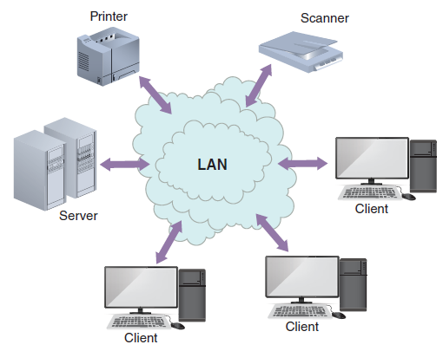
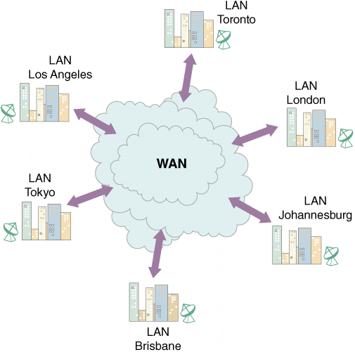
The Evolution of System Architecture (4 of 4)
FIGURE 10-4 A LAN allows sharing of data and hardware, such as printers and scanners.
FIGURE 10-5 A WAN can connect many LANs and link users who are continents apart.

Slide 13
Client/Server Architecture (1 of 6)
Systems divide processing between one or more networked clients and a central server
Client handles the entire user interface
Server stores data and provides data access and database management functions

Slide 14
Client/Server Architecture (2 of 6)
The client’s role
Client/server relationship must specify how the processing will be divided between the client and the server
Fat client (thick client) design: locates all or most of the application processing logic at the client
Thin client design: locates all or most of the processing logic at the server
Provides better performance as the program code resides on the server

Slide 15
Client/Server Architecture (3 of 6)
Client/server tiers
Two-tier design
User interface resides on the client
Data resides on the server
Application logic can run either on the server or client, or be divided between the client and server
Three-tier (n-tier) design
User interface runs on the client
Data is stored on the server
Has a middle layer between the client and server
Considered an application server

Slide 16
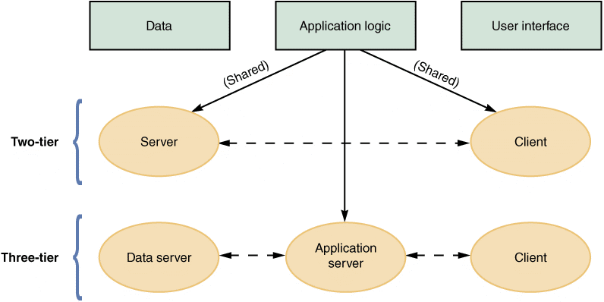
Client/Server Architecture (4 of 6)
FIGURE 10-8 Characteristics of two-tier versus three-tier client/server design.

Slide 17
Client/Server Architecture (5 of 6)
Middleware
Enables communication between tiers
Referred to as glueware
Connects two or more software components in a federated system architecture
Cost-benefit issues
Client/server systems offer the best combination of features to meet information system requirements

Slide 18
Client/Server Architecture (6 of 6)
Performance Issues
Knee of the curve: response time to requests increases significantly as the system nears its capacity
Client should contact the server only when necessary in a client/server system
Distributed database management system (DDBMS) helps improve client/server performance

Slide 19
The Impact of the Internet (1 of 3)
Internet-based architecture
Entire user interface is provided by the web server in the form of HTML documents
Shifting responsibility for the interface from the client to server simplifies data transmission and results in lower hardware cost and complexity

Slide 20
The Impact of the Internet (2 of 3)
Cloud computing
Refers to the cloud symbol that often is used to represent the Internet
The concept envisions a cloud of remote computers providing a total online software and data environment that is hosted by third parties
Eliminates compatibility issues and provides scaling on demand

Slide 21
The Impact of the Internet (3 of 3)
Web 2.0
Second generation of the web
Enables people to collaborate, interact, and share information more dynamically
Considered a step towards the semantic web
Wiki: web-based repository of information
Run by social collaboration
Users collaborate and add new layers of information to the Internet operating system

Slide 22
Ecommerce Architecture (1 of 2)
In-house solutions
Benefits
A unique website, with a look and feel consistent with the company’s other marketing efforts
Complete control over the organization of the site
A scalable structure to handle increases in sales and product offerings in the future
More flexibility to modify and manage the site
Opportunity to integrate the firm’s web-based business systems with its other information systems

Slide 23
Ecommerce Architecture (2 of 2)
Packaged solutions
Viable alternative for medium- to large-sized firms
Less complex
Service providers
Application service provider (ASP): provides applications or access to applications by charging a fee
Many offer full-scale Internet business services for companies that decide to outsource functions

Slide 24
Processing Methods (1 of 4)
Online processing
Online systems handle transactions when and where they occur and output is provided directly to users
Avoids delays and allows a constant dialog between the user and the system
Can be used with file-oriented systems

Slide 25
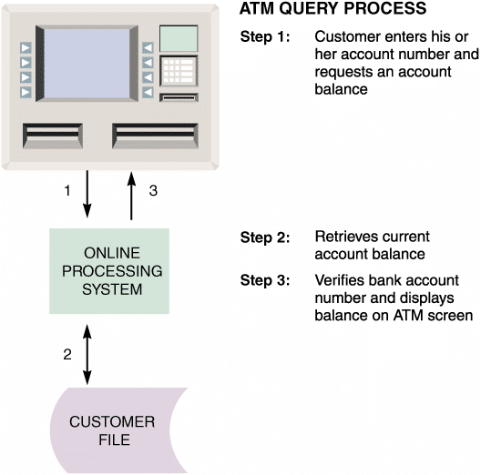
Processing Methods (2 of 4)
FIGURE 10-13 When a customer requests a balance, the ATM system verifies the account number, submits the query, retrieves the current balance, and displays the balance on the ATM screen.

Slide 26
Processing Methods (3 of 4)
Batch processing: data is managed in groups
Advantages
Tasks can be planned and run on a predetermined schedule without user involvement
Programs that require major network resources can run when costs and impact on other traffic will be lowest
Well-suited to address security, audit, and privacy concerns

Slide 27
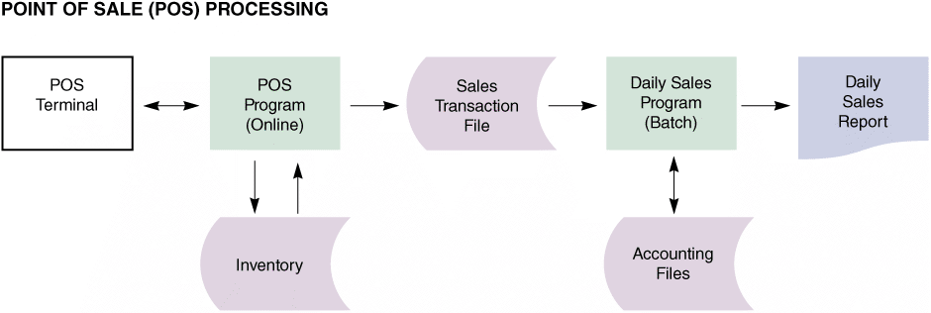
Processing Methods (4 of 4)
Example: point of sale (POS) terminals
FIGURE 10-14 Many retailers use a combination of online and batch processing. When a salesperson enters the sale on the POS terminal, the online system retrieves data from the item file, updates the quantity in stock, and produces a sales transaction record. At the end of the day, a batch processing program produces a daily sales report and updates the accounting system.

Slide 28
Network Models (1 of 8)
Open Systems Interconnection (OSI) Model
Describes how data moves from an application on one computer to an application on another networked computer
Provides physical design standards that assure seamless network connectivity, regardless of the specific hardware environment

Slide 29
Network Models (2 of 8)
Network topology
Physical or logical view of the network
Physical: actual network cabling and connections
Logical: describes the way the components interact
Hierarchical network
Departmental servers control lower levels of processing and network devices
Bus network
A single communication path connects the central server, departmental servers, workstations, and peripheral devices

Slide 30
Network Models (3 of 8)
Ring network
Resembles a circle where the data flows in only one direction from one device to the next
Star network
Has a central networking device called a switch which manages the network and acts as a communications conduit for all network traffic
Mesh network
Each node connects to every other node

Slide 31
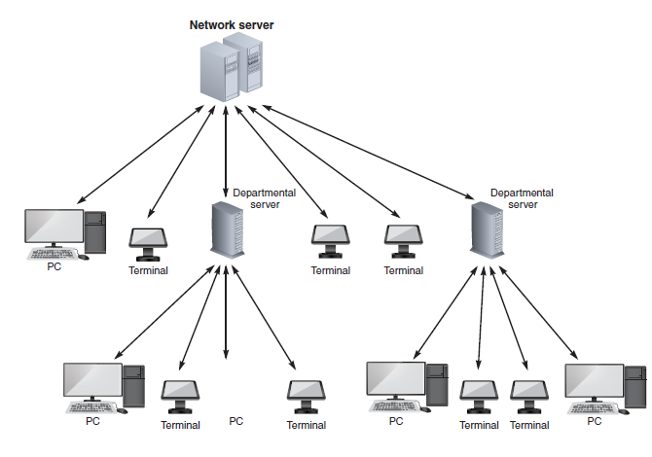
Network Models (4 of 8)
FIGURE 10-15 A hierarchical network with a single server that controls the network.

Slide 32
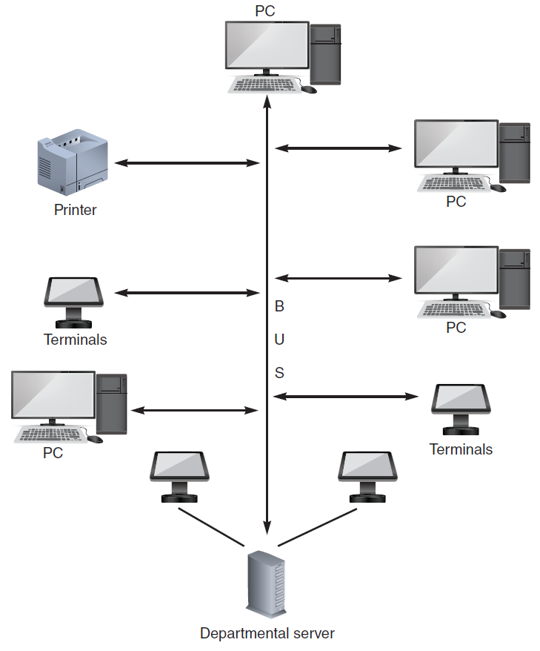
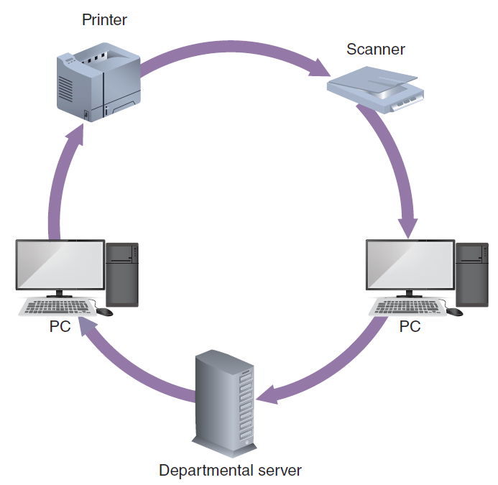
Network Models (5 of 8)
FIGURE 10-16 A bus network with all devices connected to a single communication path.
FIGURE 10-17 A ring network with a set of computers that send and receive data flowing in one direction.

Slide 33
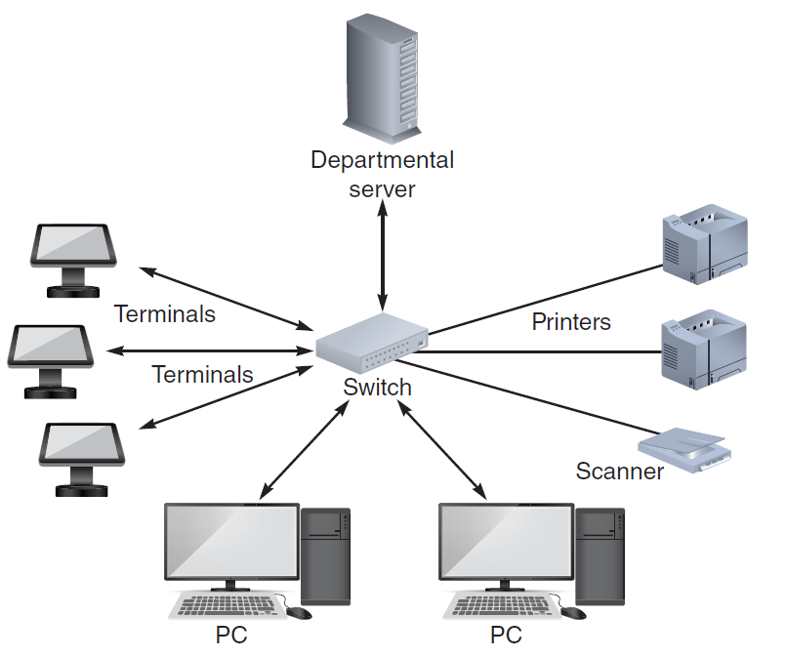
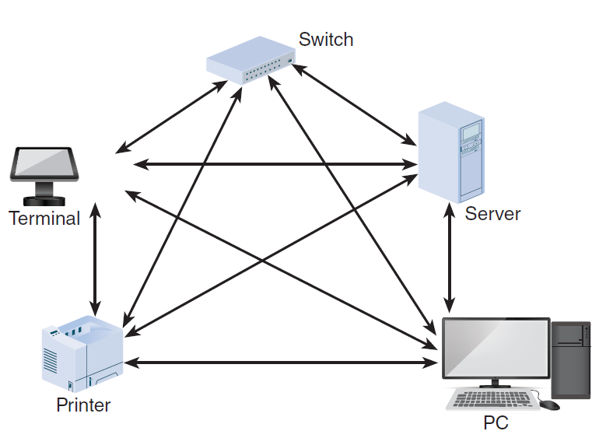
Network Models (6 of 8)
FIGURE 10-19 A mesh network is used in situations where a high degree of redundancy is needed, such as military applications. The redundant design provides alternate data paths, but is expensive to install and maintain.
FIGURE 10-18 A typical star network with a switch, departmental server, and connected computers, and workstations.

Slide 34
Network Models (7 of 8)
Network devices
LANs or WANs can be interconnected using routers
Router: connects network segments, determines most efficient data path, and guides flow of data
Proxy server: provides Internet connectivity for internal LAN users

Slide 35
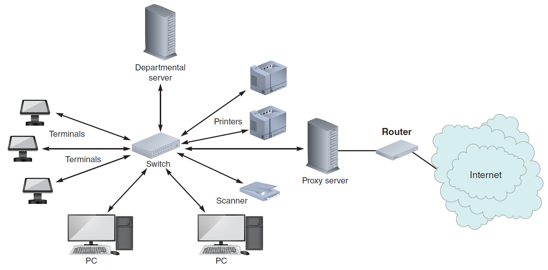
Network Models (8 of 8)
FIGURE 10-20 Routers can be used to create gateways between different network topologies and large, dissimilar networks such as the Internet.

Slide 36
Wireless Networks (1 of 3)
Standards
IEEE 802.11 is a family of standards developed by the Institute of Electrical and Electronics Engineers (IEEE) for wireless LANs
Current wireless networks are based on variations of the original 802.11 standard
Multiple input/multiple output (MIMO) technology boosts performance

Slide 37
Wireless Networks (2 of 3)
Topologies
Network topologies available for IEEE 802.11 WLANs
Basic Service Set (BSS) or the infrastructure mode
Extended Service Set (ESS)

Slide 38
Wireless Networks (3 of 3)
Trends
Wi-Fi Alliance
International association that certifies interoperability of wireless network products based on IEEE 802.11 specifications
Bluetooth
Used for short-distance wireless communication

Slide 39
System Design Completion (1 of 5)
System architecture marks the end of the systems design phase of the SDLC
Final activities in the systems design phase
Preparing a system design specification
Obtaining user approval
Delivering a presentation to management

Slide 40
System Design Completion (2 of 5)
System design specification
Document that presents the complete design for a new information system
Contains detailed costs, staffing, and scheduling for completing the next SDLC phase
Used as a baseline to measure the operational system

Slide 41
System Design Completion (3 of 5)
Sections in a system design specification
Management summary
System components
System environment
Implementation requirements
Time and cost estimates
Additional material

Slide 42
System Design Completion (4 of 5)
User approval
Users must review and approve the interface design, report and menu designs, data entry screens, source documents, and other areas of the system that affect them
Ensures approvals are obtained as and when required
Keeps the users involved with the system’s development
Provides feedback that can be used to guide efforts
System design specification should be reviewed by other IT department members as well

Slide 43
System Design Completion (5 of 5)
Presentations
Provide an opportunity to explain the system, answer questions, consider comments, and secure final approval
First presentation is to the systems analysts, programmers, and technical support staff members
Next presentation is to the department managers and users from departments affected by the system
Final presentation is delivered to management
Management will reach a decision based on the presentation

Slide 44
Summary (1 of 4)
An information system combines hardware, software, data, procedures, and people into a system architecture
Before selecting an architecture, the analyst must consider enterprise resource planning, initial cost and TCO, scalability, Web integration, legacy interface requirements, processing options, security issues, and corporate portals

Slide 45
Summary (2 of 4)
ERP establishes an enterprise-wide strategy for IT resources and specific standards for data, processing, network, and user interface design
A system architecture requires servers and clients; client/server architecture divides processing between one or more clients and a central server
A thick client design places all or most of the application processing logic at the client

Slide 46
Summary (3 of 4)
A thin client design places all or most of the processing logic at the server
Client/server designs can be two- or three-tier
The Internet has had an enormous impact on system architecture
The most prevalent processing method today is online processing

Slide 47
Summary (4 of 4)
Networks allow sharing of hardware, software, and data resources to reduce expenses and provide more user capability
The way a network is configured is called the network topology
The system design specification presents complete design for an information system and is the basis for the presentations that complete the systems design phase

